Slide 1
Matrix Plots
Module 02
Data Science Developer

Slide 2
Matrix Plots
Matrix plots allow you to plot data as color-encoded matrices and can also be used to indicate clusters within the data (later in the machine learning section we will learn how to formally cluster data).
Let's begin by exploring seaborn's heatmap and clutermap:

Slide 3

Imports

Slide 4
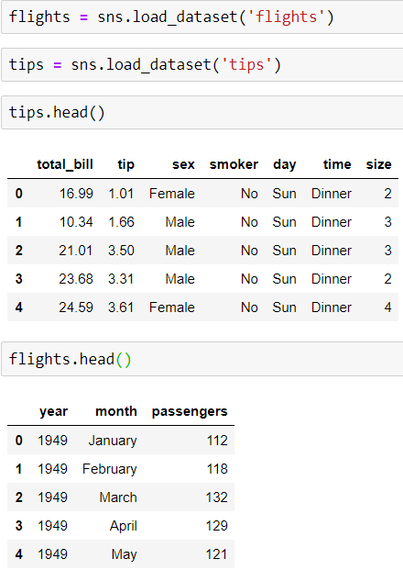
Data

Slide 5
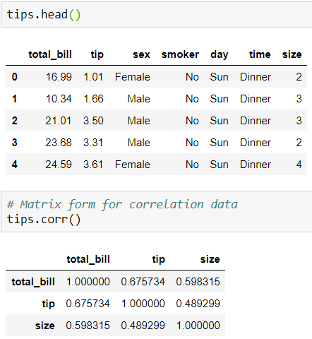
Heatmap
In order for a heatmap to work properly, your data should already be in a matrix form, the sns.heatmap function basically just colors it in for you. For example:

Slide 6
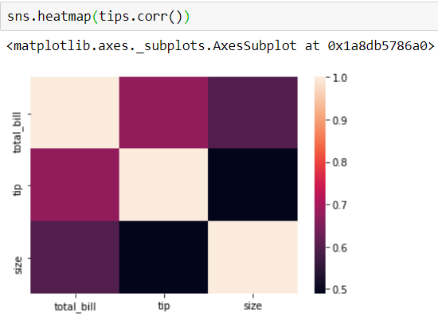
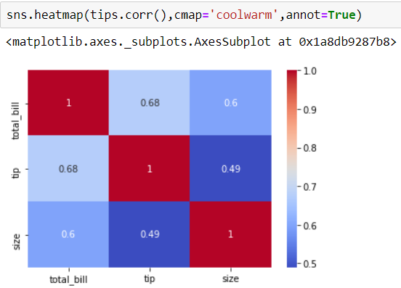

Slide 7
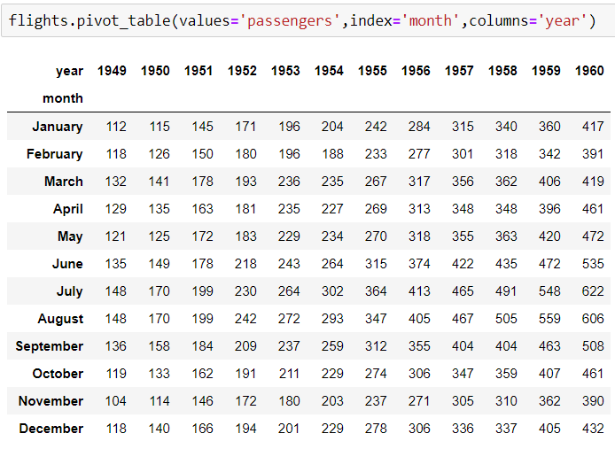
Or for the flights data:

Slide 8
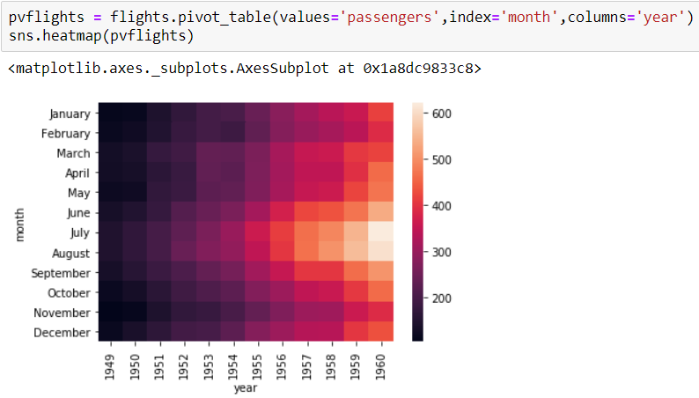

Slide 9
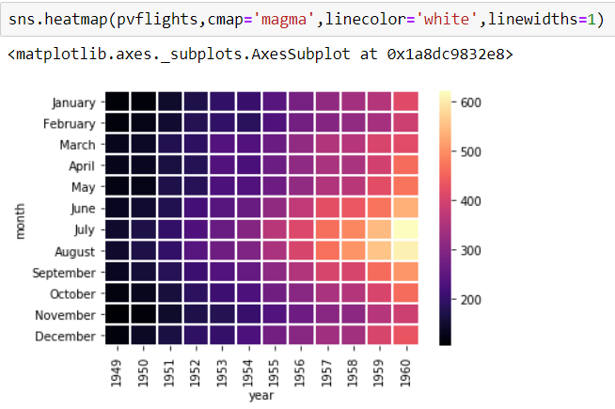

Slide 10
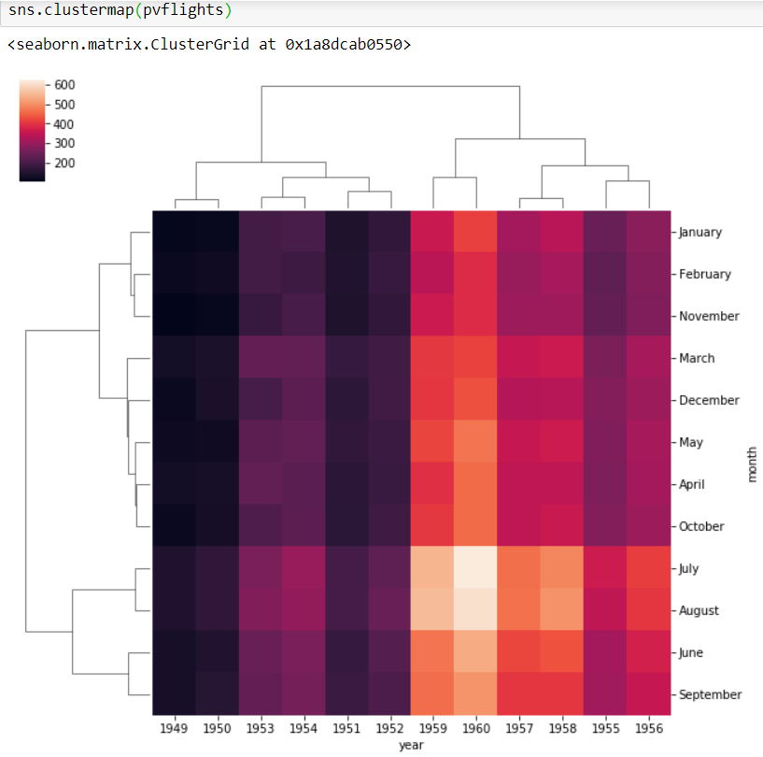
clustermap
The clustermap uses hierarchal clustering to produce a clustered version of the heatmap. For example:

Slide 11
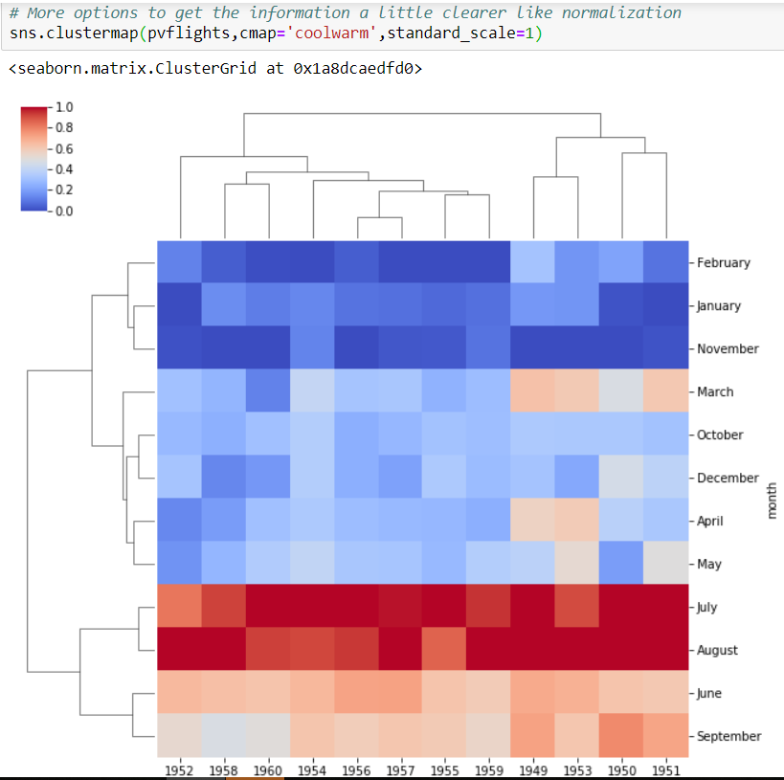
Notice now how the years and months are no longer in order, instead they are grouped by similarity in value (passenger count). That means we can begin to infer things from this plot, such as August and July being similar (makes sense, since they are both summer travel months)

